Slide 1
Microsoft for Retail

Slide 2
Agenda

Slide 3
About Our Company

Slide 4
Retail Challenges Worldwide

Slide 5
New Business Disruptors

Slide 6
Retailer Responses Customer-Centricity

Slide 7
Important Factors for Today’s Retailer

Slide 8
Microsoft in Retail What it means to you

Slide 9
Microsoft in Retail What it means to you

Slide 10
Microsoft in Retail What it means to you

Slide 11
Microsoft in Retail What it means to you

Slide 12
Microsoft Dynamics Retail Products

Slide 13
MSFT Dynamics Retail Management System

Slide 15
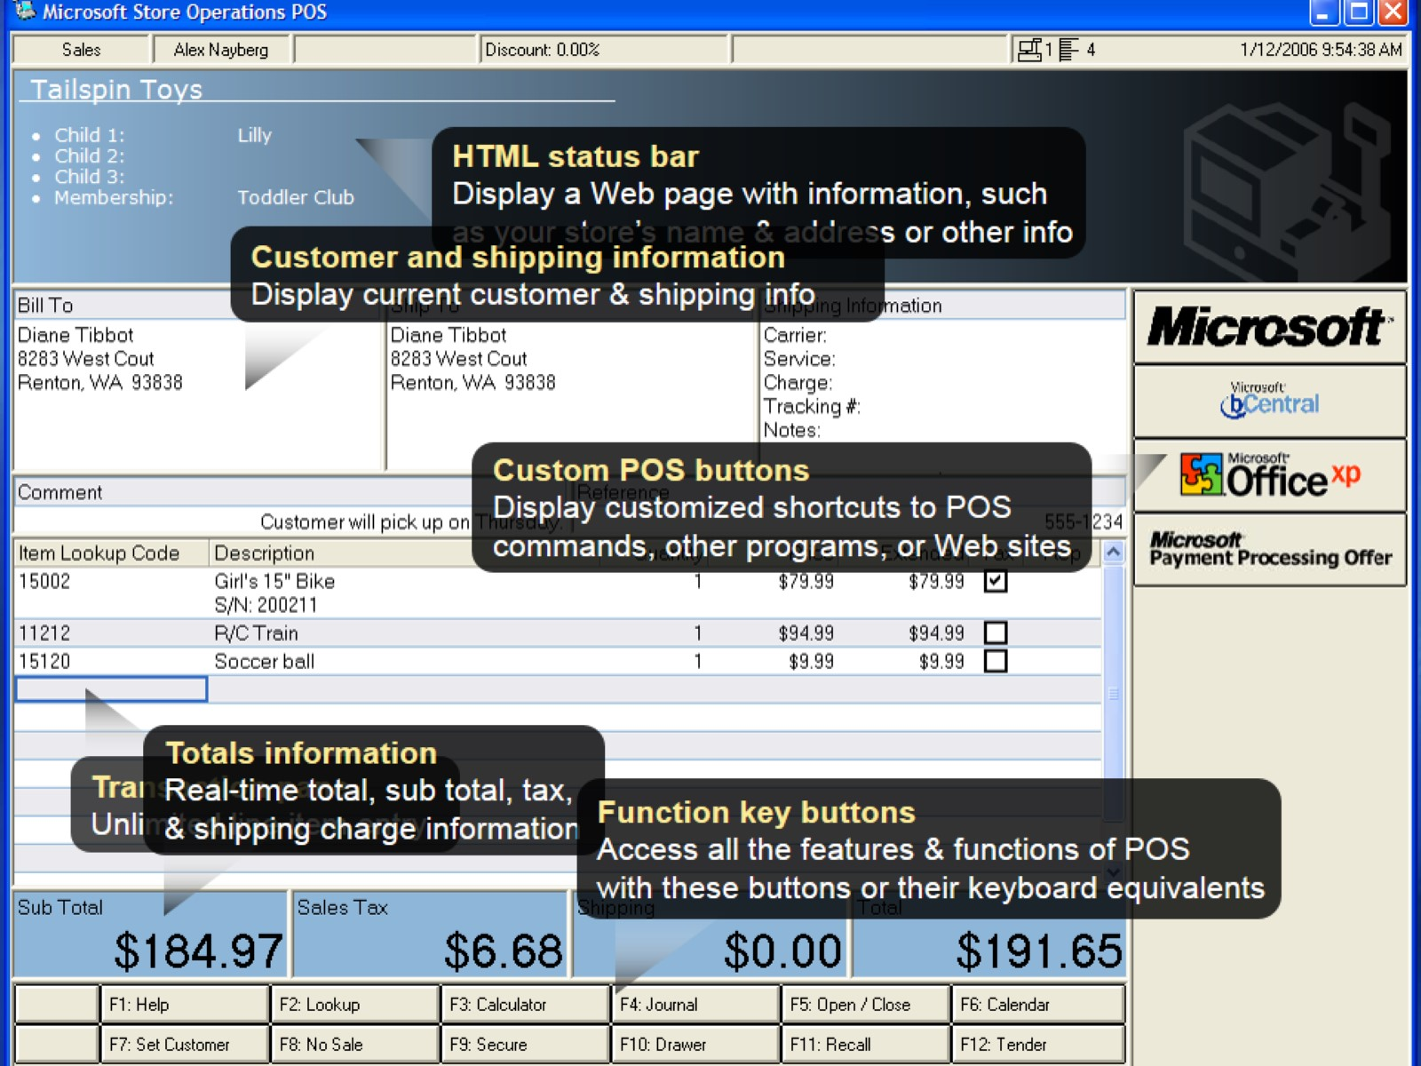

Slide 21
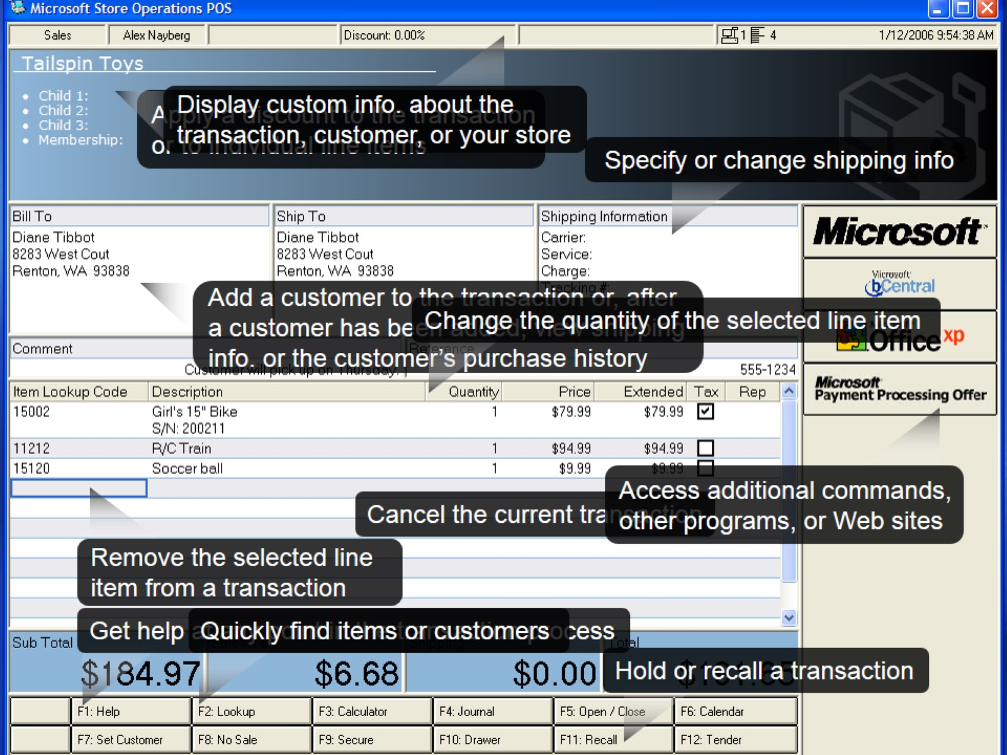

Slide 25
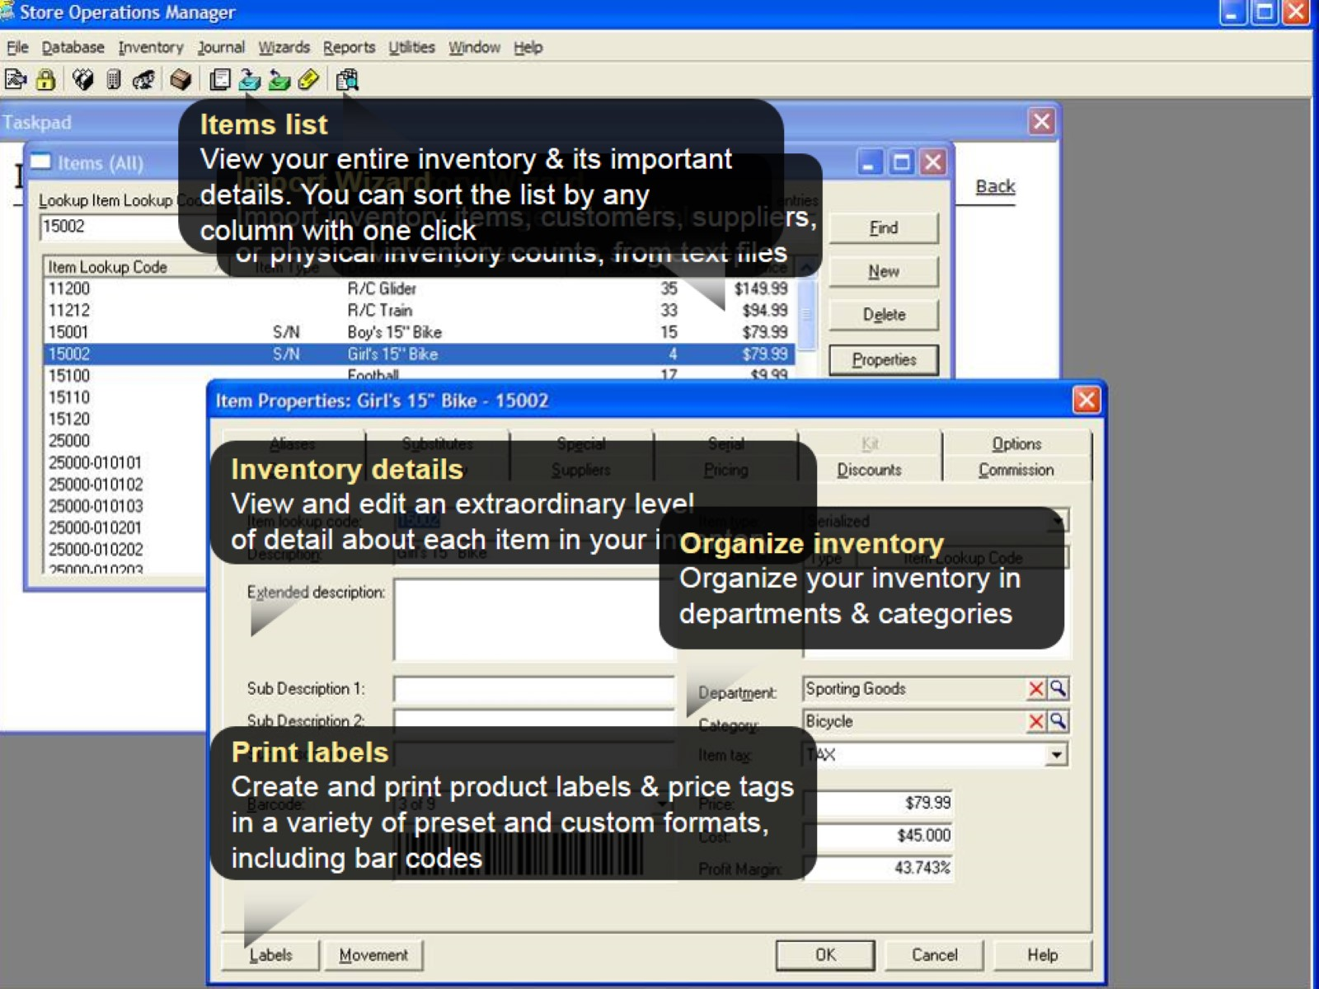

Slide 27
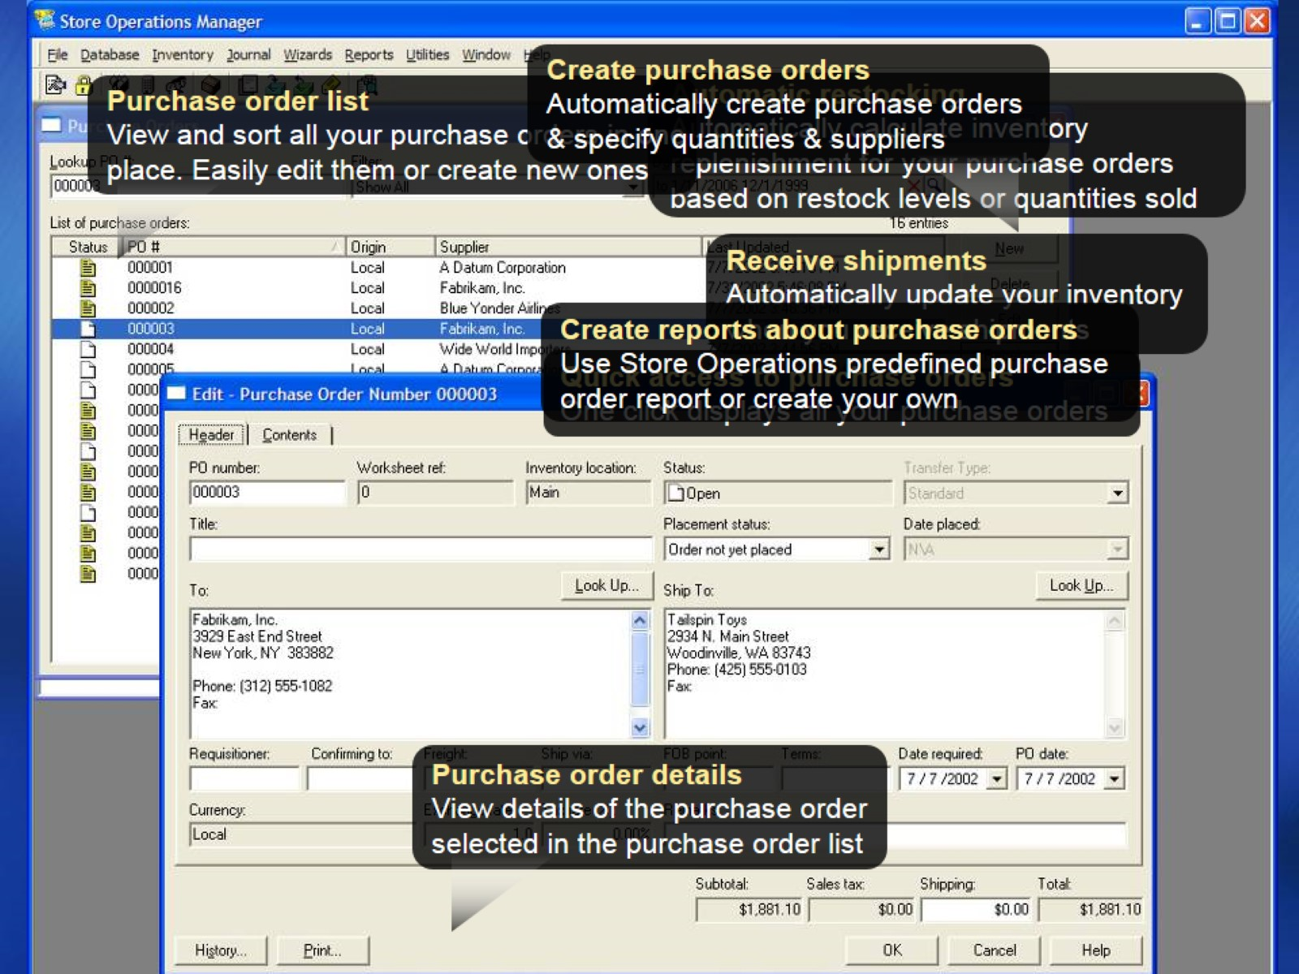

Slide 29
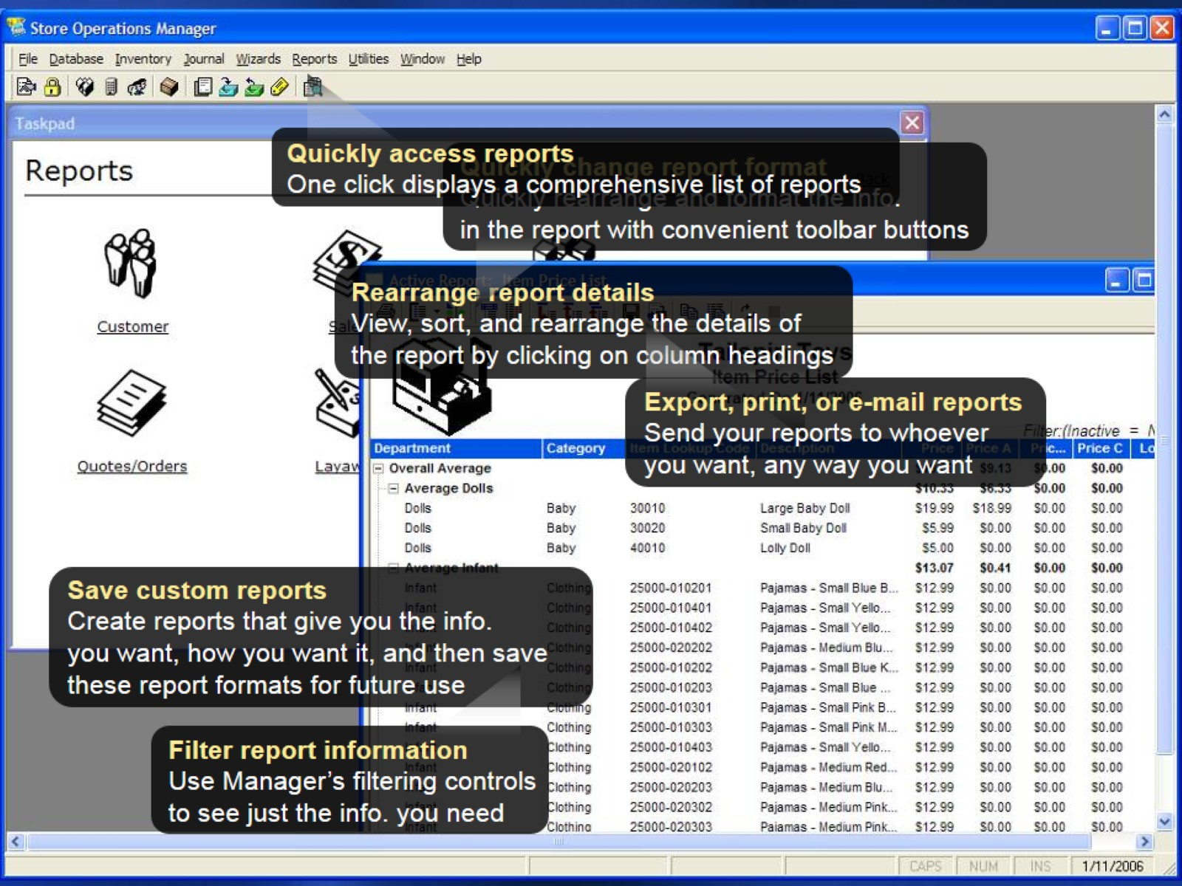

Slide 31
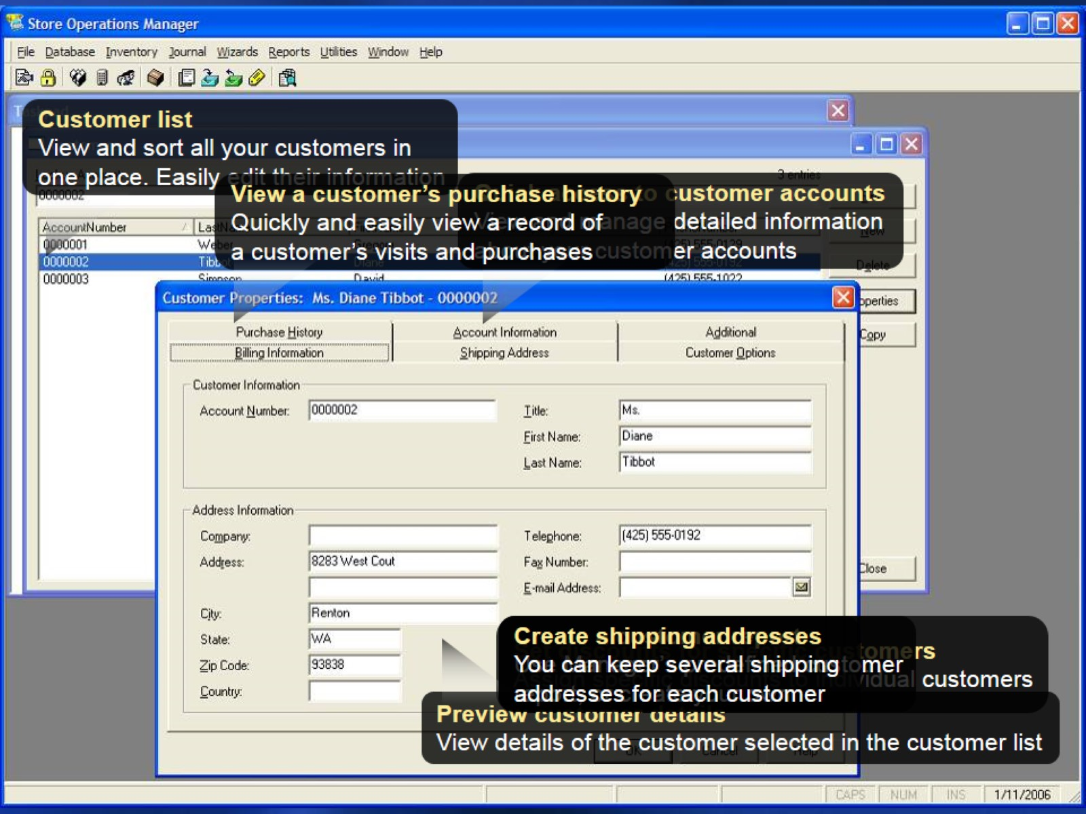

Slide 32
MSFT Dynamics RMS key advantages

Slide 33
Microsoft Dynamics RMS (Retail Management System)

Slide 34
Microsoft Dynamics RMS (Retail Management System)

Slide 35
Microsoft Dynamics RMS (Retail Management System)

Slide 36
Microsoft Dynamics RMS (Retail Management System)

Slide 37
Microsoft Dynamics RMS (Retail Management System)

Slide 38
Microsoft Dynamics RMS (Retail Management System)

Slide 41
Microsoft Dynamics RMS (Retail Management System)

Slide 42
Microsoft Dynamics RMS (Retail Management System)

Slide 45
INFINITE SOLUTIONS www.infinite.com.mk

